Slide 1
CSI-3450 FINAL PROJECT
Trevor McKinstrey, Alex Carson, Cyrus Verkest

Slide 2
Problem Statement
System Requirements
This group will create A program for seeing information on different heroes and items in the game Dota 2, that can be edited to be up to date with current patches of the game. This will allow players to find any necessary information about different elements of the game.
The program will allow for storage of information about the different heroes in Dota 2, and an authorization system will be used so admins can update the information on different abilities if necessary. Data will be viewable through a GUI for any user, and a search system will be implemented to look for heroes with certain attributes.

Slide 3
Functional Requirements
This system will allow users to retrieve hero statististics
This system will allow users to retrieve ability statistics
This system will allow users to retrieve talent information
This system will allow users to retrieve item statististics
This system will allow users to retrieve a list of heroes related to a certain playstyle
This system will allow users to sort heroes by primary attribute and role
This system will allow users to sort items based on attributes
This system will allow administrators to update hero information
This system will allow administrators to update ability information
This system will allow administrators to update talent information
This system will allow administrators to update item information

Slide 4
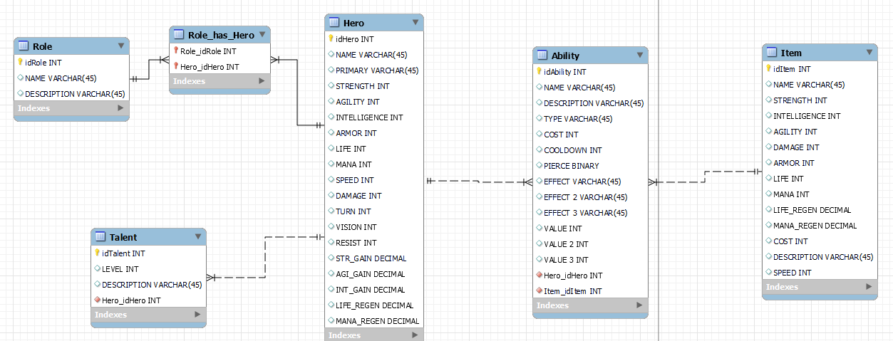
Conceptual ER Diagram

Slide 5
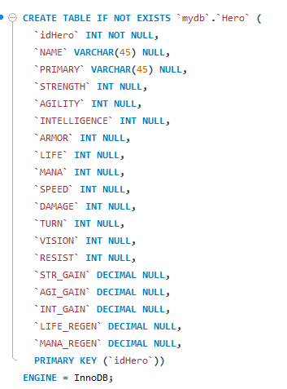
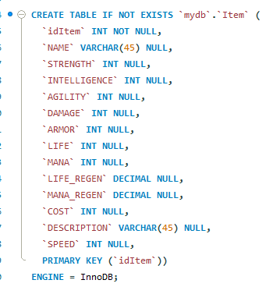
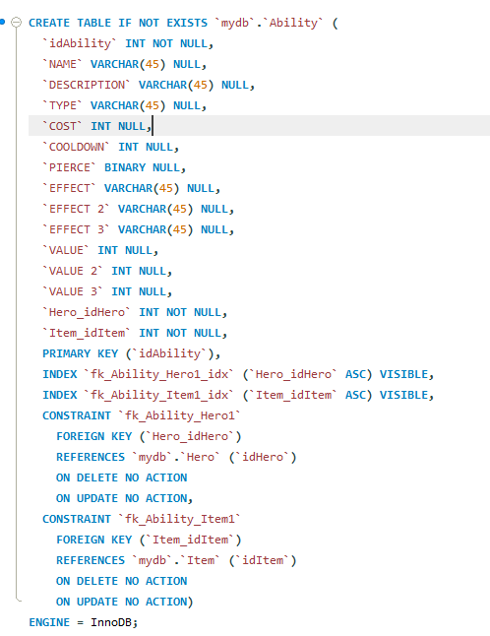
SQL implementation

Slide 6
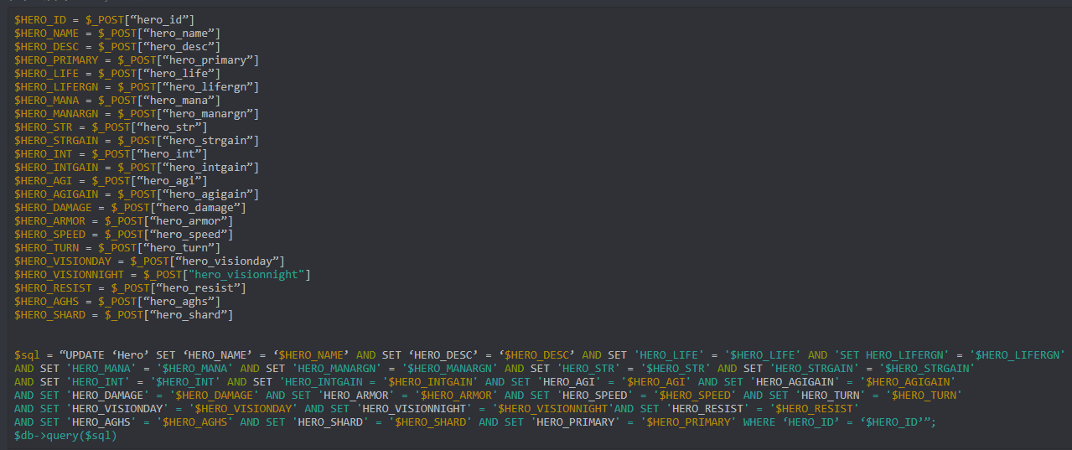
Updating values using php script

Slide 7
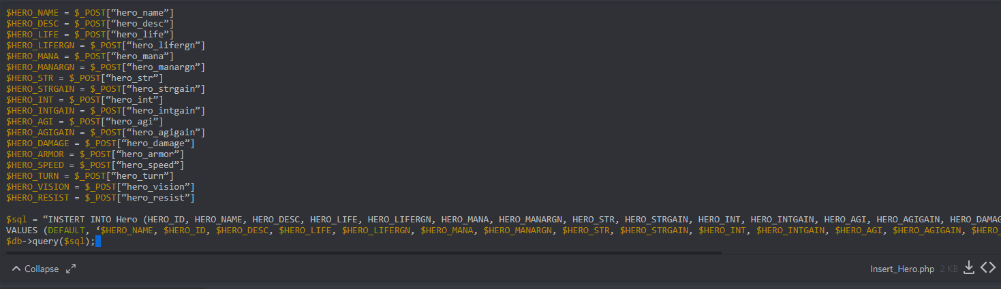
Inserting values using php script

